Slide 1

A Machine Learning optimization model for oil production
By:
Sailendra Mahapatra | Vivek Baghel
Data Analytics & Visualization Bootcamp
Rice University - Trilogy

Slide 2
Project 1
Contents:
Introduction
Data source and Methodology
Data Analysis
Data Statistics
ML Classifiers – Ensemble analysis on aggregate samples
Ridge Regression Variance Model
KNN on oil production categories (ranges)
Conclusions
Acknowledgements

Slide 3
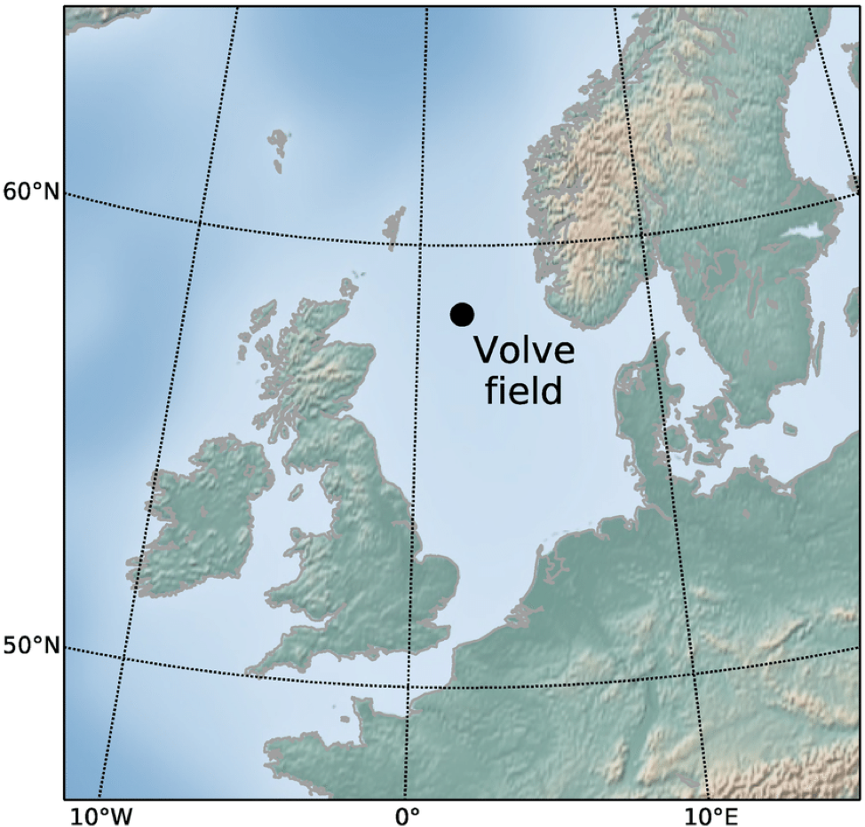
Final Project
Introduction:
Norway
N. Sea
UK
Location Map : Equinor’s oil field production from 2008 to 2016

Slide 4
Final Project
Data source & Methodology:
Data source: https://data.equinor.com/dataset/Volve
Daily production data:
Pressure Readings – Well Head, Tubing Downhole
Choke size
On stream hours
Temperature
Oil production rate
Methodology: Data cleaning,
Regression analysis and ML classifier clusterings coding to formulate an oil production
prediction model
Software used: Python (Pandas & Matplotlib), Numpy, Ski-Learn (Ridge regression, Random forest,
Decision Tree', K-NN, Bagging Tree, Bagging K-NN, Mlxtend plotting

Slide 5
Data Analysis :
Data Statistics
 | AVG_Downhole Pressure | AVG_Downhole Temp | AVG_DP Tubing | AVG_CHOKE Size_% | AVG_WHP Pressure | AVG_WHT Pressure | DP Choke Size | BORE_OIL Volume
count | 7996 | 7996 | 7996 | 7996 | 7996 | 7996 | 7996 | 7996
mean | 178.52148 | 77.620934 | 151.322 | 61.15385 | 45.22788 | 75.98779 | 16.18717 | 1251.611
std | 106.92566 | 45.820701 | 73.005 | 33.72532 | 18.98735 | 17.82514 | 17.38256 | 1343.785
min | 0 | 0 | 0 | 0.6 | 0 | 0 | 0 | 0
25% | 0 | 0 | 56.5555 | 33.5451 | 31.9405 | 71.15125 | 3.3545 | 271
50% | 229.4175 | 104.8925 | 175.401 | 59.2044 | 38.192 | 81.8745 | 8.799 | 715.5
75% | 251.59475 | 106.377 | 203.671 | 100 | 54.952 | 88.43275 | 23.995 | 1651
max | 314.778 | 108.502 | 259.087 | 100 | 120.889 | 93.51 | 106.035 | 5902

Slide 6
ML Classifiers – Ensemble analysis on aggregate samples
Random Forest Analysis :
rf Score (trained) 0.99
rf Score (test) 0.01
Features relevance :
OVER FITTED
Other Ensemble Boosting methods :
Various data averaging/boosting techniques
are attempted –
Prediction accuracies are not improved

Slide 7
Ridge Regression Variance Model

Slide 8
KNN on oil production categories (ranges)
Individual Wells
Train
Train
Test
Test
Test
Train
Test Acc: 0.762
Test Acc: 0.634
Test Acc: 0.771
Train
Test
Test
Train
Test
Train
Test Acc: 0.757
Test Acc: 0.900
Test Acc: 0.973
Oil production categorized in ranges of 250 barrels (Total 24 ranges for 0 to 6000 barrels)

Slide 9
KNN on oil production categories (ranges)
All Wells
k: 15, Train/Test Score: 0.732/0.700
Oil production categorized in ranges of 250 bbl (Total 24 ranges for 0 to 6000 barrels)

Slide 10
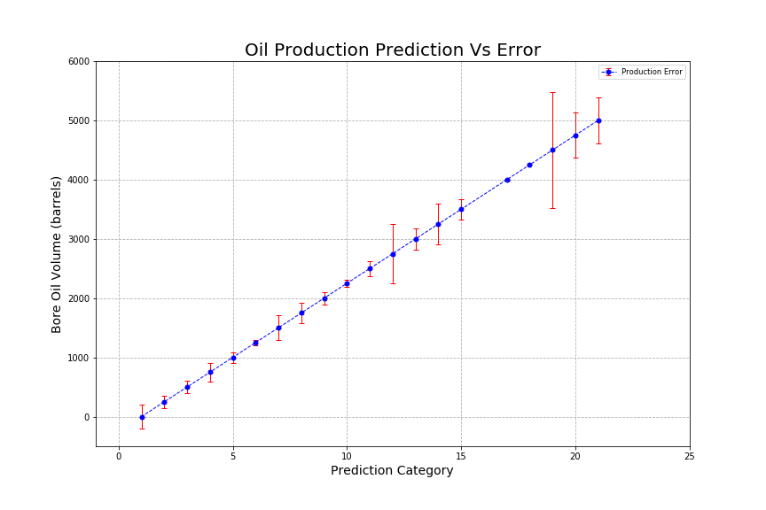

Slide 11
Conclusions:
Dataset is of non-Gaussian distribution for a complex geological structure of field
ML ensemble classifiers show low prediction score
- doubtful feature importance(over/under fitting)
Ridge Regression shows data variability scenarios and yielded
maximum prediction score of 0.41
Categorized the daily oil production in to 24 ranges (250 bbls interval),
KNN analysis on individual wells show better test accuracy (>.75),
on aggregate wells yields a train/test score: 0.732/0.7
The model predicts better for the lower category oil production ranges up to 11 (2750 bbls)
While the model performance in terms of prediction accuracy fits to the historical data,
further analysis on the prediction modeling is planned by generating
a time-differenced dataset from the time-series dataset

Slide 12
Acknowledgements:
We are thankful to our mentor/instructor Camden Kirkland for his valuable guidance, time and constant encouragement.
Our sincere thanks to Trilogy and Rice University for conducting the Boot Camp and allowing us to learn and carry out the present analysis
Thanks are also due to Equinor oil company for the dataset, Python/Lib/SkiLearn developers for their coding modules

Slide 13
Thank You for your time and patience !

